Slide 1

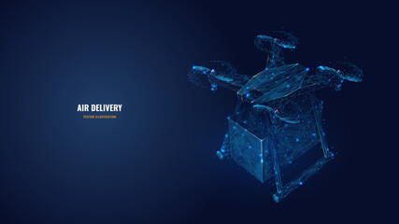

Drone Collision
AVOIDANCE SYSTEM
Jan 2022 - May 2022
Under the supervision of :
Dr. Joy Prakash Misra
01

Slide 2






Team Members
Kartik Kankurte
Koustubh Mane
Himanshu Kumar
Ayush Lall
Ankit Barwar
20135058
20135063
20135048
20135024
20135019

Slide 3

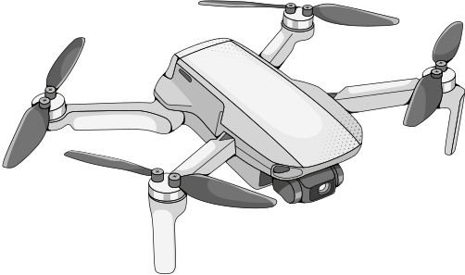
EXPLORATORY PROJECT
ABSTRACT
2. ROS
3 .LIDAR
4. FLIGHT CONTROL
Content
5. BUG
6. POTENTIAL FIELD METHOD
7. CONCLUSION
03

Slide 4


Today Drones are present everywhere at the war front, in delivering products,​
photography, search and rescue, detecting a fault in high power lines, and many more, increasing at​
a rapid pace. The emerging global market for business services using drones is valued at over $127B, according to PricewaterhouseCoopers.​
Due to rapid advancements in drone technologies, we can see that the number of drones present is​
skyrocketing. However, most of the drones are controlled by humans. So, in the real world dynamic​
environment, there is always a possibility of collision with trees, birds, other drones, and worst, with​
another human. So, our team uses intelligent algorithms and Computer vision to give autonomous collision avoidance capabilities to drones.​
We will be using Robot operating system(ROS) which will used to control the drone using message passing between different processes and package management.​
LiDAR is used to detect the obstacle in the path of drone. ​
We use algorithms like Flight control algorithm and BUG algorithm. ​
For path planning we use potential field algorithm. By this the drone can reach the goal point by avoiding obstacles.
PART 1
Solway
ABSTRACT
04

Slide 5
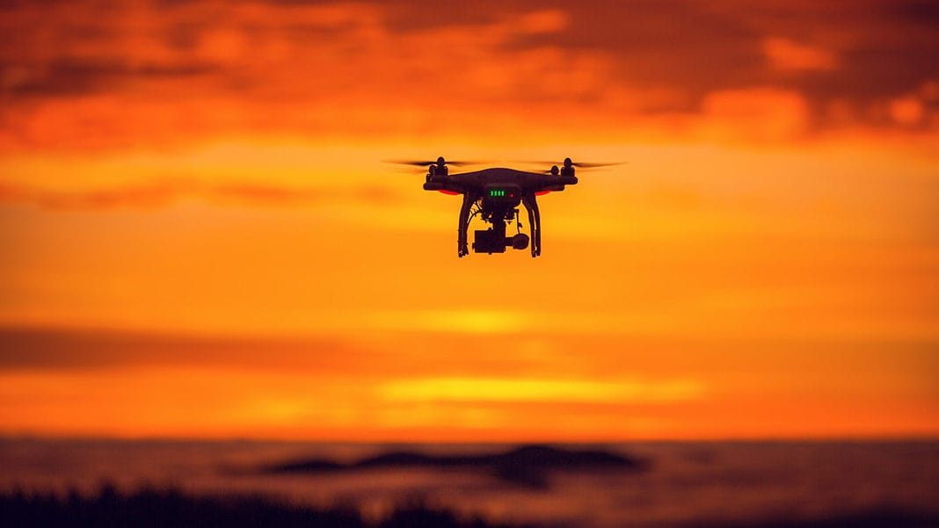
ROBOT OPERATING SYSTEM
Robot operating system (ROS) is a open source, meta operating system i.e. it is like a hybrid between a normal operating system and a framework.
It provides all the services you would expect from any operating system, including hardware abstraction, low-level device control, implementation of commonly-used functionality, message-passing between processes, and package management.
05

Slide 6
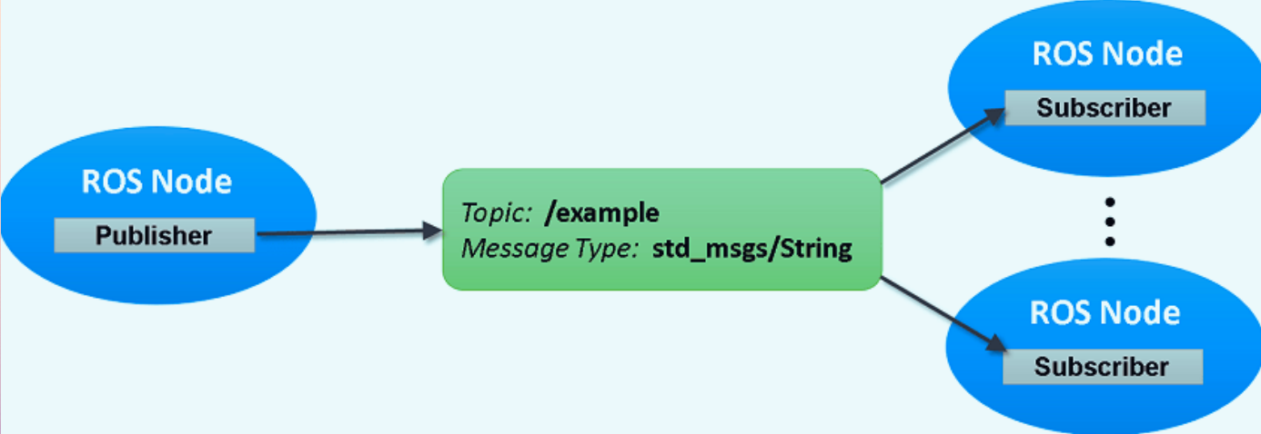
This example shows how to publish and subscribe to topics in a ROS network. It also shows how to:
Wait until a new message is received.
Use callbacks to process new messages in the background.
06

Slide 7

The primary mechanism for ROS nodes to exchange data is sending and receiving messages. If a node wants to share information, it uses a publisher to send data to a topic. A node that wants to receive that information uses a subscriber to that same topic.
This publisher and subscriber communication has the following characteristics:
Topics are used for many-to-many communication. Many publishers can send messages to the same topic and many subscribers can receive them.
Publishers and subscribers are decoupled through topics and can be created and destroyed in any order. A message can be published to a topic even if there are no active subscribers.
07

Slide 8

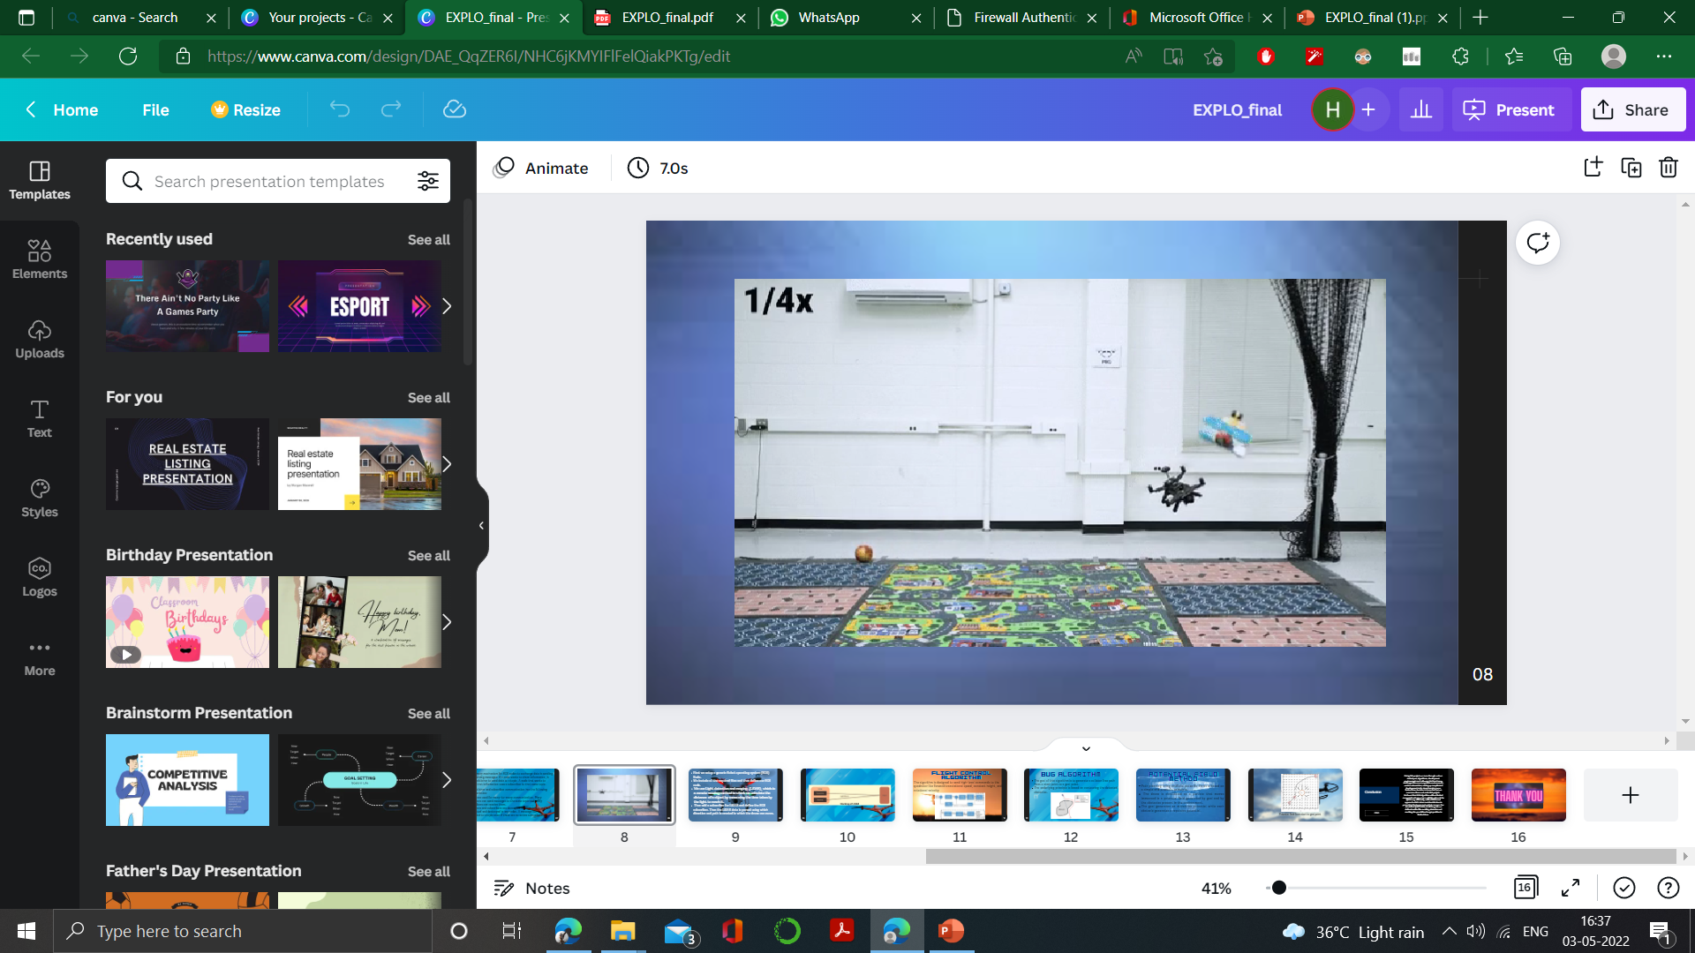
22 of these pairs of chromosomes are the same in males and females. The 23rd pair differ between males and females.
08

Slide 9
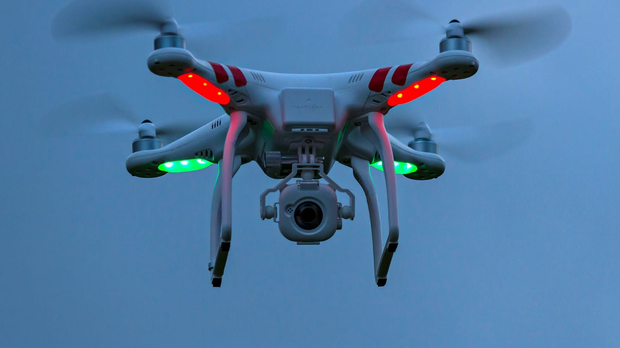
First we setup a generic Robot operating system (ROS) Node.
We include all the required files and then define our ROS node.
We use Light detection and ranging (LiDAR), which is a remote sensing method in which we calculate the distance of a object by measuring the time taken by the light to reach it.
Then add a subscriber for LiDAR and define the ROS subscriber. Then the LiDAR data is parsed using which direction and path is created in which the drone can move.
09

Slide 10

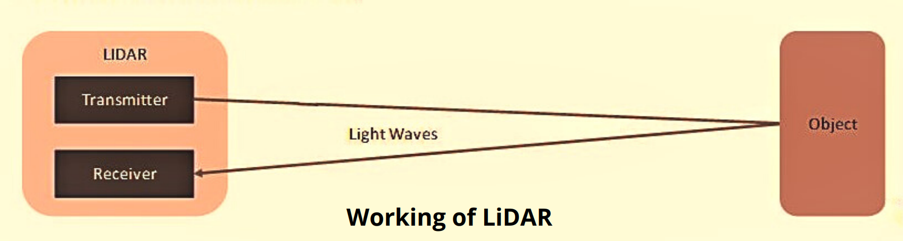
10

Slide 11
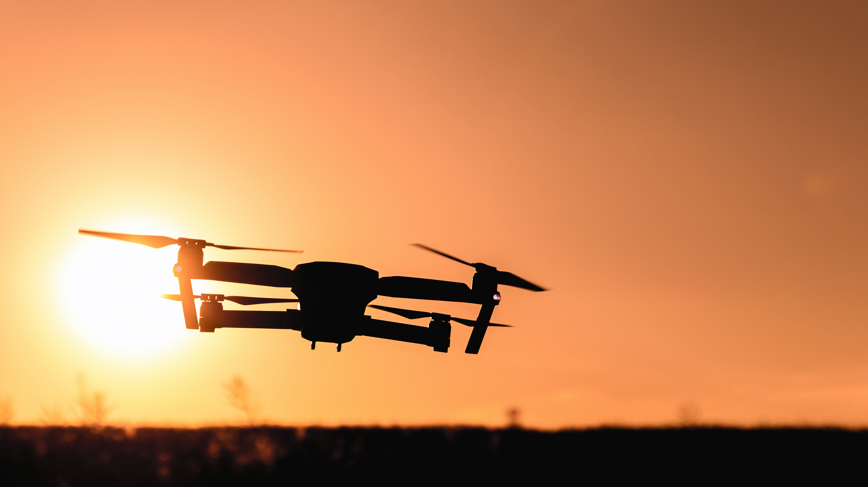
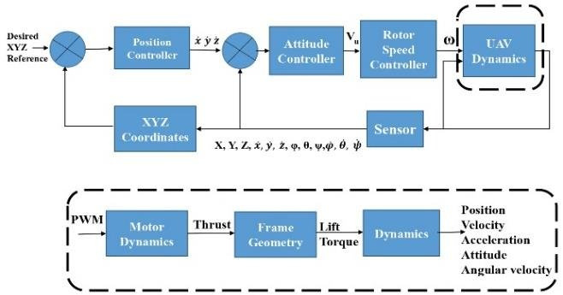
FLIGHT CONTROL ALGORITHM
The algorithm is designed to send high-level commands to the quadrotor like forward translational speed, constant height, and rotational velocity
11

Slide 12
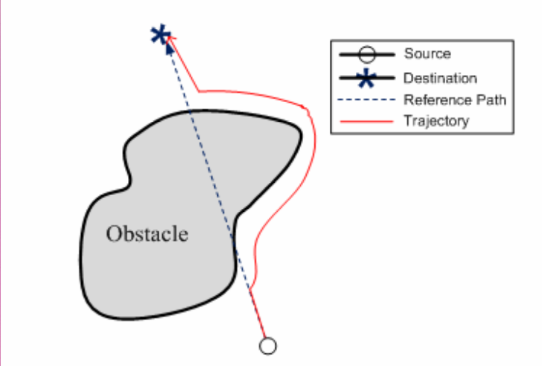
BUG ALGORITHM
The goal of this algorithm is to generate a collision free path from a start point to a goal point.
The underlying principle is based on contouring the detected obstacles.
12

Slide 13
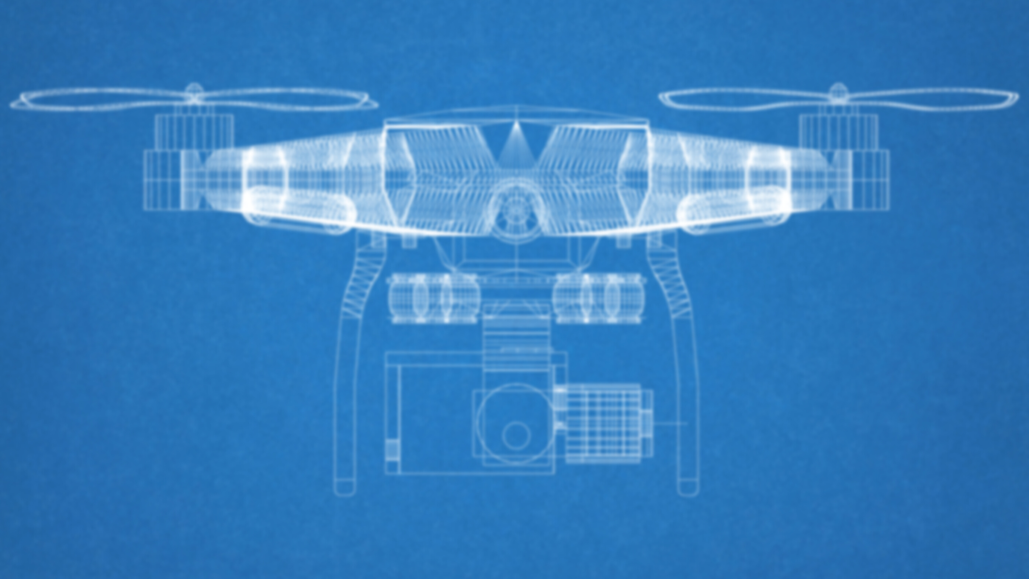
POTENTIAL FIELD METHOD
Path planning using artificial potential fields is based on a simple and powerful principle.
The drone is considered as a particle that moves immersed in a potential field generated by goal and by the obstacles present in the environment.
The goal generates an attractive potential while each obstacle generates a repulsive potential.
13

Slide 14
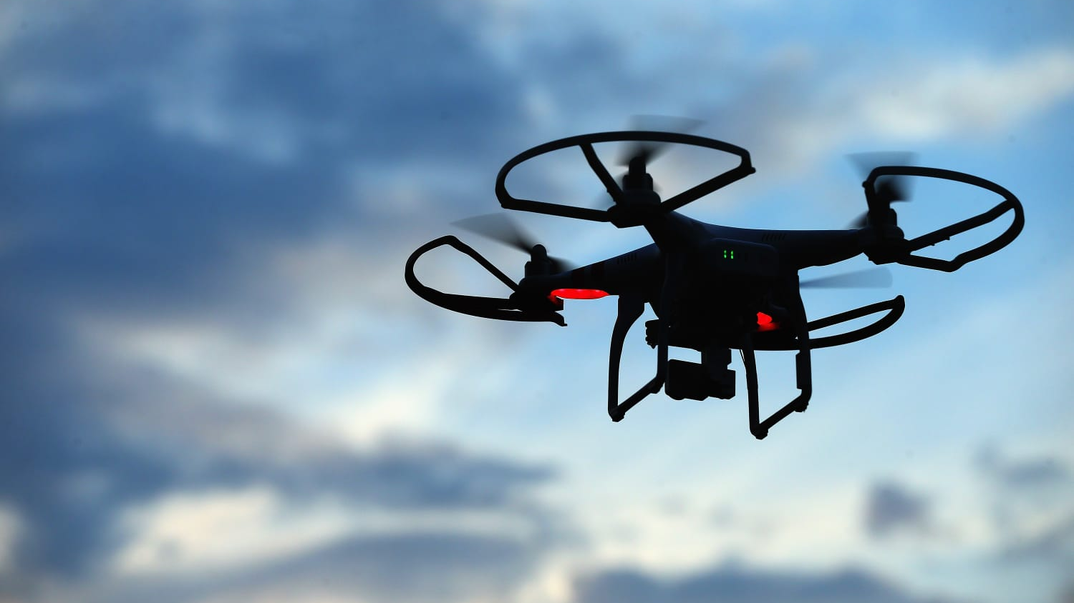
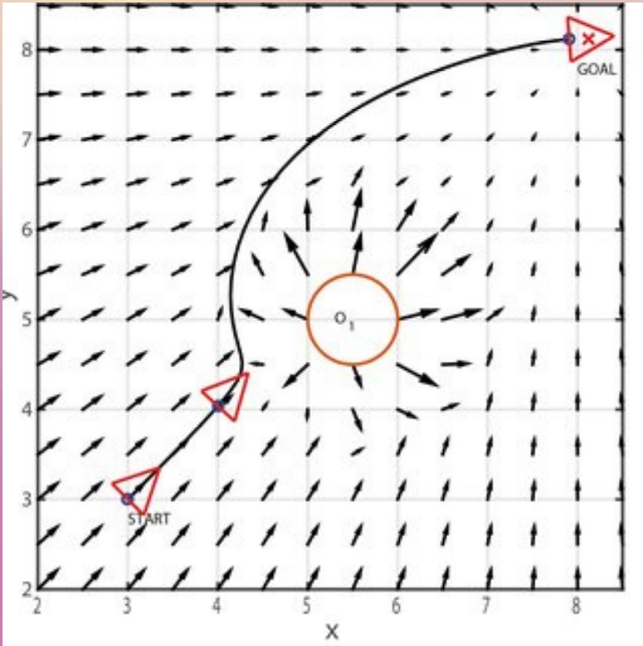
Potential field from start to goal point
14

Slide 15
Doing this project we came through various techniques, algorithms, development environments and software. We faced many challenges like non-compatible environments, version mismatches, setting up complicated development tools, steep learning curve, limited time duration to name few but we overcame them and made this project.
We found that BUG algorithm utilizes limited computational resources available onboard the QUAV very efficiently unlike DNN based approach which takes considerable time in processing the image captured via camera. Our simulated QUAV achieved all the goals we defined earlier like avoiding obstacles and reaching the pre-defined target position in limited time.
Conclusion
DCAS
15

Slide 16

THANK YOU

